Slide 1
Microprocessors, Microcontrollers, and Embedded Systems
CSE 315

Slide 2
Information
Course teachers
A. B. M. Alim Al Islam (Razi) – AAI
Atif Hasan Rahman – AHR
Classes
3 lectures per week
Saturdays at 12pm (AHR)
Sundays and Mondays at 12pm (AAI)
Moodle
Zoom links, slides and other resources

Slide 3
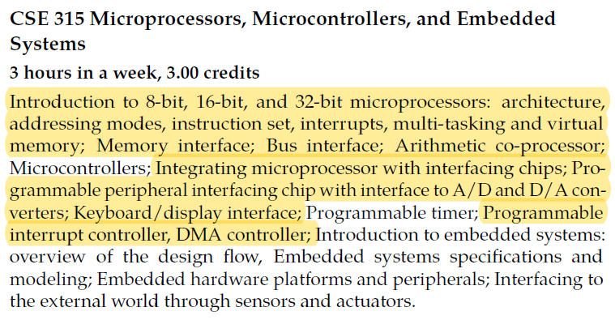
Outline
Highlighted sections will be covered by AAI

Slide 4
Outline
Microprocessors
A. B. M. Alim Al Islam
Two classes per week in the first half
One class per week in the second half
Microcontrollers and embedded systems
Atif Hasan Rahman
One class per week in the first half
Two classes per week in the second half

Slide 5
CSE 316 Outline
Microprocessors, Microcontrollers, and Embedded Systems Sessional
Assignments on assembly language
Assignments on microcontrollers (ATmega32)
Project on embedded systems

Slide 6
CSE 315 Outline - AHR
Assembly language
~ 4 weeks
Microcontrollers
~ 5 weeks
Embedded systems
~ 5 weeks

Slide 7
Textbooks
Assembly language
Ytha Yu, Charles Marut, Assembly Language Programming and Organization of the IBM PC

Slide 8
A Typical Computer System Early days
Memory
Central Processor Unit
(CPU)
Input
Output

Slide 9
A Typical Computer System Nowadays
Input
CPU
Memory
Output
Shared BUS

Slide 10
Microprocessor
Microprocessor, by-itself, is completely useless
must have external peripherals to interact with outside
world
CONTROL
µP
ADDRESS
BOOT ROM
Used at startup
Instruction (program) ROM
Transducers
Keyboard Screen UART Parallel interface
etc
Data RAM
DATA
Many chips on mother board

Slide 11
MicroCONTROLLER
µC
CONTROL
ADDRESS
DATA
µP
ROM
RAM
I/O PORTS
BOOT ROM
Used at startup
Instruction (program) ROM
Transducers
UART Parallel interface
Etc
Data RAM
TIMER
Microcontroller – put a limited amount of most commonly used resources “inside” the chip – a “limited” amount is often “enough” for many applications

Slide 12
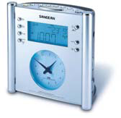
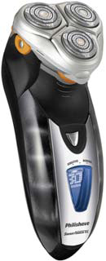
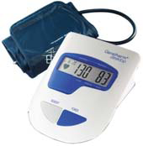
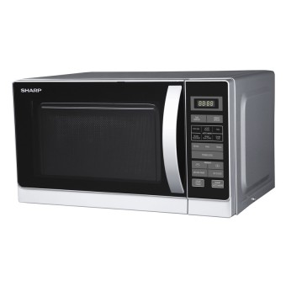
Uses of μC

Slide 13
μP vs μC
 | μP | μC
Structure | CPU | CPU, memory, I/O
Uses | Computer system | Embedded system
Purpose | General | Specific
Cost | High | Low
No. instructions supported | Large | Fewer
Speed | Fast | Slower
Power consumption | High | Low
Architecture | von Neumann | Harvard

Slide 14
Embedded systems
An embedded system is a computer system that has a dedicated function within a larger mechanical or electrical system
Usually based on microcontrollers
Complex ones can have microprocessors too
Examples
Automobiles and airplanes
Medical devices
Home appliances

Slide 15
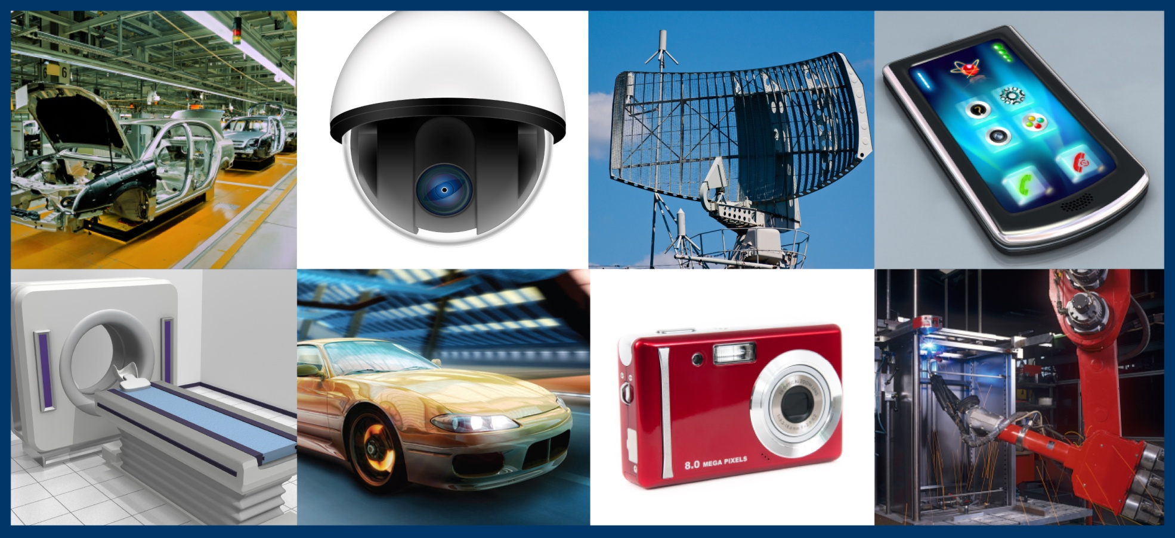
Embedded systems

